Slide 1
Part 1: 100% Off Coupons

Slide 2
100% Off Coupons
How to Sell Software for Nothing and Actually Turn a Profit

Slide 3
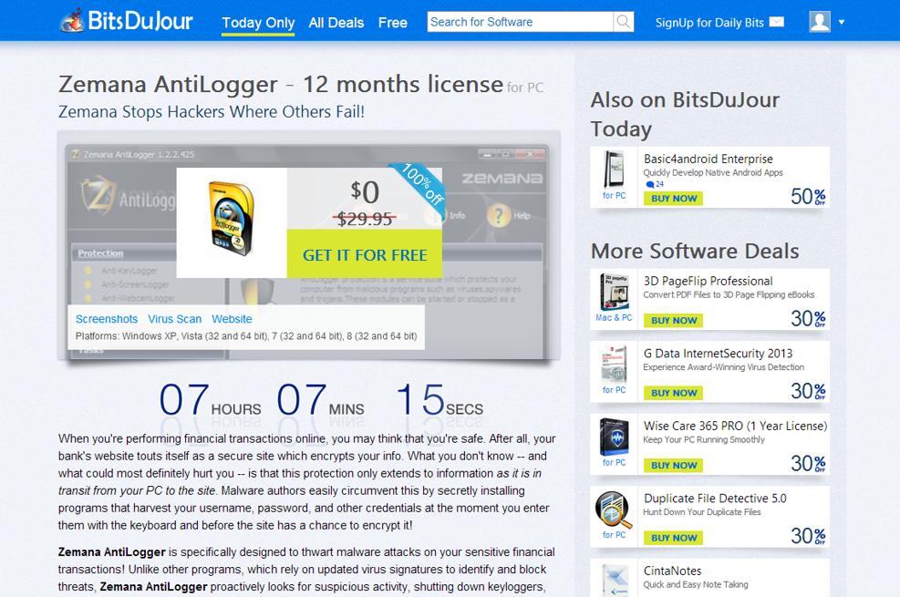
BitsDuJour Features your Software at 100% Off for 24 hours

Slide 4
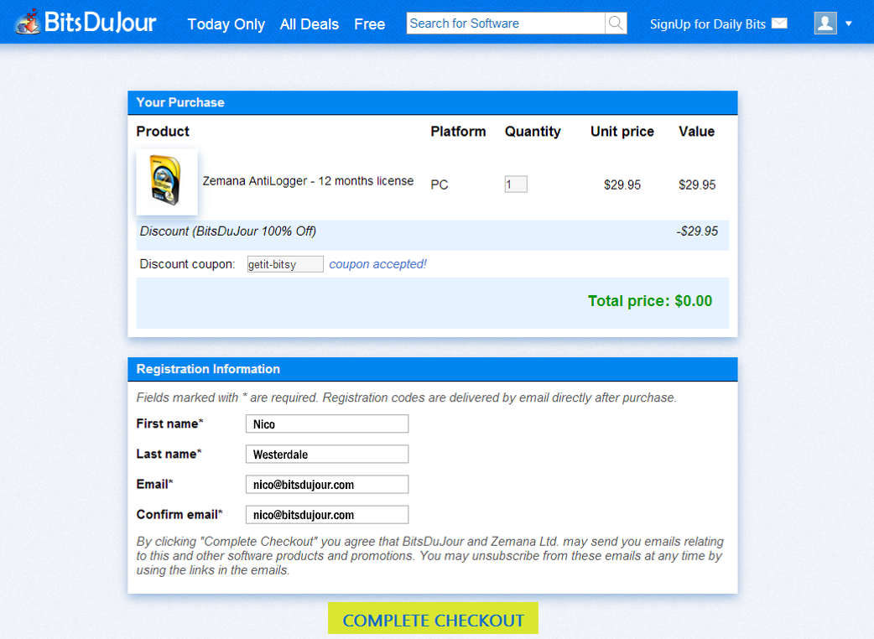
Customers use the BitsDuJour Checkout to Purchase one copy each

Slide 5
Customers Agree for You to Send them Emails After the Promotion

Slide 6
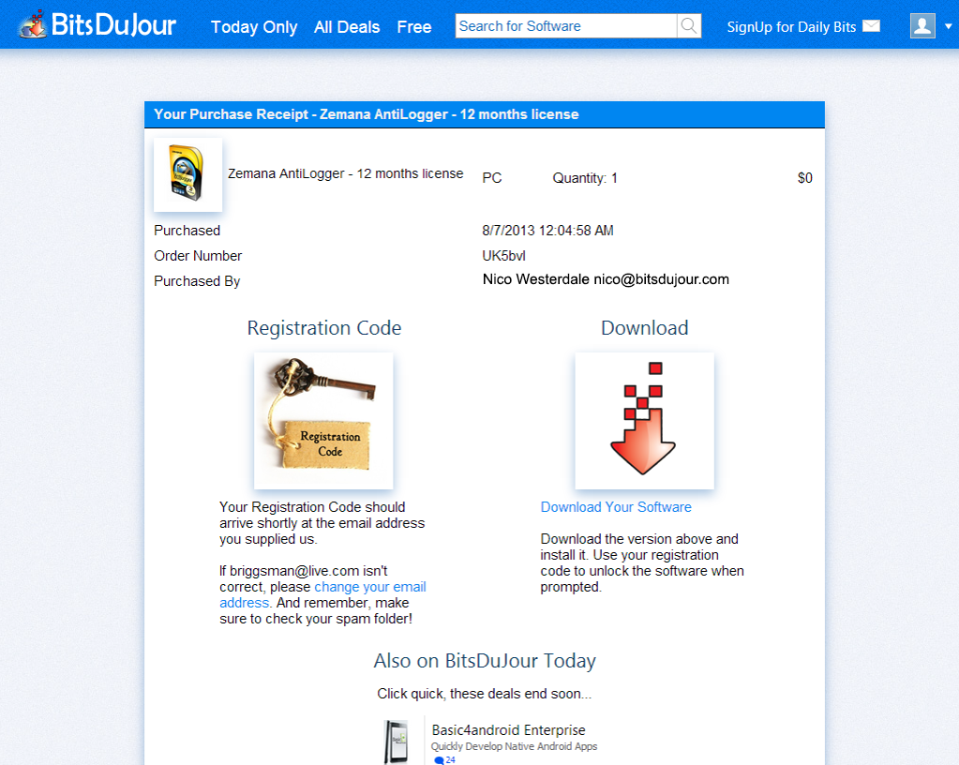
The Purchase is Quick, and Directs Customers to Check their Email

Slide 7
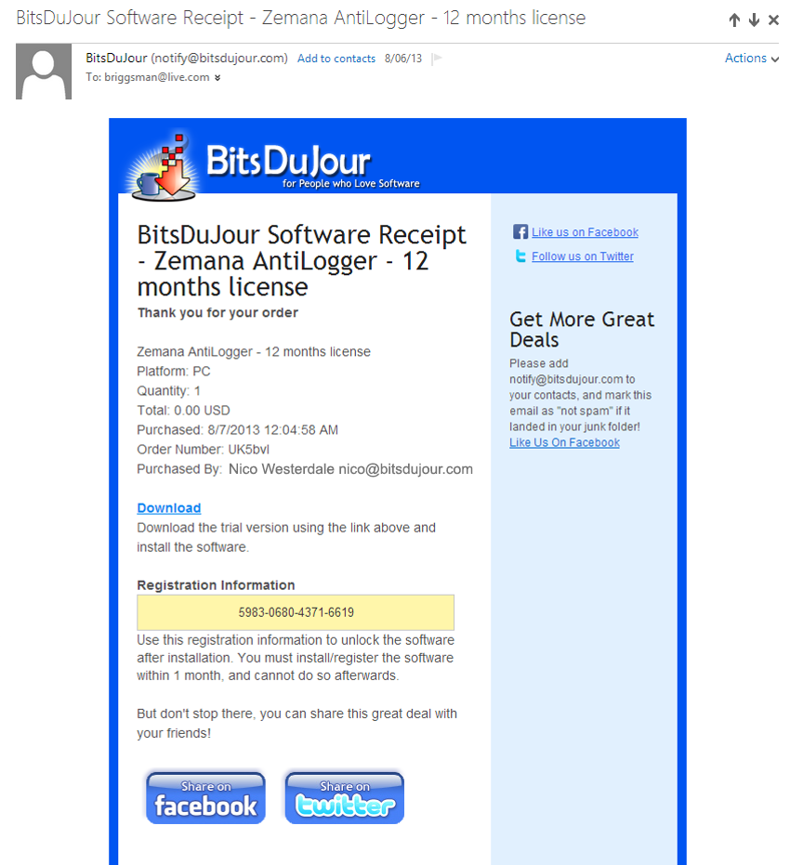
Customer Receives Registration Code in an Email from BitsDuJour

Slide 8
After the Promotion
bits@pops.com boris@sofmatterz.co.uk
jason@hat.com
bobby@hopscotch.com
drago@fastpace.ru
bitster@gmail.com
brandy@applovers.net
thepossum@aande.com
softwareking@gmail.com
carephilly@chzbrgr.com
iluvbill@hotmail.com
macfan@apple.com
...
Download the Thousands of Email Addresses and Add them to Your List

Slide 9
Send Regular Emails
Upgrade to Pro Version!
Promote Other Software!
Update to the Newest!
Create new Sales from your Expanded Email List of Fans

Slide 10
100% Off Coupons
The New Service that Builds You an Email List of Dedicated Software Fans
Contact roger@bitsdujour.com

